Slide 1
Color Quality Scale
Measuring the color quality of light sources
Notes:
Marcel van der Steen, working at OliNo to stimulate alternative energy application and energy saving. We do lamp measurements since 2007 and make results public in order to everyone to inform well how to save energy and choose the best lamp fitting the application needs.
In this presentation I will dive into details with regard to a quality parameter belonging to light emitted by lamps.

Slide 2
Materials used
Toward an improved color rendering metric, W. Davis and Y. Ohno, 2005
Presentation CQS Wendy Davis 2010
Rationale of color quality scale, W. Davis and Y. Ohno, 2010
Color Quality Scale Excel file v 9.0.3 Y. Ohno+notes 2011
Presentation Color Perception and Lighting by Sophia Sotiropoulou 2013
Notes:
The following presentation is made by using materials from the following papers, presentations and implementations. These can also be found in the internet.

Slide 3
Color Rendering
Notes:
A practical example of color rendering. Left light from a source that has equal energy in its power spectrum. And below the colors how they are visualized. Then right a spectrum of a different source that has some peaks in its spectrum. The color of the light itself is still white for us humans. However when the same items are lit, then the colors seen are very different. So colors are rendered differently.

Slide 4
Good color rendering costs lm/W
Notes:
Color rendering such that it delivers natural, appealing colors and with light that enables us to easily discriminate between colors, does come at a cost, of efficacy.

Slide 5
Color rendering index (CRI)
Notes:
In short the color rendering index, and how it is determined. All is done via mathematical computations.
We start with the test source upper left. It emits light with a certain spectrum.
We calculate its correlated color temperature (CCT). When this value is less than 5000 K we take as reference source a black body radiator with the same color temperature and otherwise we use standard daylight with the same color temperature.
We use a set of reference samples that we will light with the light of the test and reference source and we calculate the resulting color points.
The color points of the light coming from the reflective samples that were lit by the test sources will be corrected for chromatic adaptation (later more).
Then the differences between the corrected reflective color points when lit with the test source and the reflective color points when lit with the reference source are calculated.
Then results for each color sample an R-value, and the average of the R1 – R8 is called Ra which we know as the CRI value.
A value of 80 or more is recommended for areas where people work daily.

Slide 6
Measuring color differences
Notes:
The CRI is based on differences in color points of the reflective samples when lit by the test source and when lit by the reference source.
For the CRI the CIE WUV is used but this diagram shows a figure that is not homogeneous for all colors.
The later invented CIE LAB is much more homogeneous and recommended by the CIE.

Slide 7
Color spaces for meas. difference
15 reflective CQS samples in CIE 1976 L*a*b* and CIE 1964 W*U*V* color spaces
CIE 1964: color differences extremely exaggerated in red and suppressed in yellow and blue regions.
Notes:
Left the CIE LAB diagram, used by the CQS, indicating 15 reflective samples of the CQS and shown to be relatively well distributed around the origin.
Right the WUV diagram, used by the CRI, indicating that the same reflective samples are at very different distances from the origin.
For instance red is at value 120 for U*. A difference of 10 points for this value is less noticeable as a color change than a difference of 10 points for the yellow/green color at V* = 20.

Slide 8
Color rendering index (CRI)
The CRI was designed to evaluate fluorescent lamps
The CRI was intended to measure the ‘naturalness’ of objects’ colors, not preference
Reflective samples (1st eight) chosen to represent “average” saturation of objects, not fully saturated
Has had no substantive changes in 35 years
Narrowband LED spectra showed the characterizing limits of CRI
LEDs’ CRI result does not correspond to its: 1) level of being visually appealing, 2) naturalness, 3) ability to discriminate between colors

Slide 9
Problems with the CRI
Notes:
As with the CRI the medium saturated colors are tested (the average of the first 8 reflective samples), a small deviation for these samples could lead to an unacceptable deviation for more saturated colors.
With LED spectra an optimisation for the CRI value is possible while making unacceptable color rendering for saturated colors.

Slide 10
Saturation and Naturalness
Notes:
When objects are lit under high luminance, then the colors appear more saturated than when lit with low luminance, as is the case in all indoor illumination situations. Therefore, when the light spectrum of an artificial light could enhance the colors by making them a bit more saturated, then this will be more appealing (more vivid) for the eye.

Slide 11
Problems with the CRI
Notes:
Here a lamp that enhances the colors by making them more saturated. This will result in more appealing colors however is penalized by the CRI in the way it is calculated; it deviates from the reference and therefore is penalized.

Slide 12
Problems with the CRI
Notes:
LED spectra can also be tuned to generate a spectrum that generally enhances the colors of objects that are lit. And also here this is penalized by the CRI.

Slide 13
Color quality scale (CQS)

Slide 14
Color quality scale (CQS)

Slide 15
Reflective sample set
Notes:
So the CQS has a new and bigger reflective sample set for its one value output. The sets of CRI and CQS are compared in the diagram in the upper right, where one can see a good and even distribution of points for the CQS samples as well as the colors being more saturated.
The set has been updated from v7.5 to v9.0 in order to have less samples close to yellow and more in the blue region. So to distribute a bit better,
The CQS samples are indicated to the right bottom and come from an excel sheet calculating according to CQS v9.0.

Slide 16
Root mean square

Slide 17
Saturation factor
A: not penalized for increase of chroma (however there is a limit since v9, see next page)
B: penalized for decrease of chroma
C: penalized for hue shift, but not for increase of chroma (however a limit, see next page)
Notes:
As explained, some more saturation while maintaining the same color (hue) is not penalized.

Slide 18
Saturation factor since v9.0
Max tolerable increase in chroma
is +10
Notes:
However, since the CQS v9.0 there has been put a max for the color enhancement. Not more than 10 points in order to maintain the appealing effect. Too much saturation would decrease its appealing effect as indicated by the graph left. The graph right shows the acceptable area for a specific CQS path, in which no degradation is done on the CQS value.

Slide 19
Saturation factor example
Color-desaturating light (R_{a}=82, Q_{a}=74) Color-enhancing light (R_{a}=71, Q_{a}=83)
Notes:
Herewith a practical example of an improvement of the color impression when enhancing them.
Left the image lit by light with the given characteristics where Ra is high as the color points do not deviate much. CQS is lower than CRI as the CQS focuses on more saturated colors whereas the CRI focuses on less saturated colors.
And right the situation where the color points of the test source are more enhanced. Therefore penalized by the CRI but not by the CQS.

Slide 20
New scaling factor
The CQS prevents negative values.
CRI values below 35 are affected.
Values below 35 indicate bad rendering.
Notes:
The CRI could generate negative values. This could lead to confusion which is solved by the CQS implementation. Only values of less than 35 are impacted which indicates a bad color rendering anyway.

Slide 21
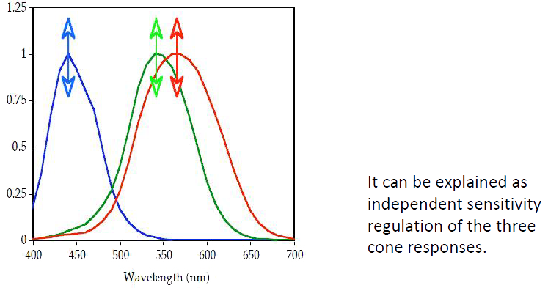
Chromatic adaptation (correction)
Chromatic adaptation is the ability of the human visual system to discount the color of the illumination and to approximately preserve the appearance of an object
(e.g. white sheet of paper under different illuminants)
CQS uses a newer Chromatic Adaptation Transform (CMCCAT2000) than CRI does.
Notes:
Color impression for the human eye remains fairly constant, even when the object is lit by different spectra. Compare it with the colors perceived on the morning sun, the afternoon sun and the evening sun. The afternoon sun is colder but does not affect our impression of colors.

Slide 22
Chromatic adaptation
Notes:
A typical example that shows our chromatic adaptation. These examples can easily been found on the internet. At first it is easily seen that the photo of the baby consists of different colors. The left part more bluish and the right part more yellowish. When one stares 30 seconds at the + sign in the left part image, and then stares at the + sign on the nose of the baby, the colors are almost equal! This shows that the visual system adapts to the color of the illumination and preserves the appearance of the object.

Slide 23
CCT factor – and removal
Light with low CCT (say < 2500K) and even CRI=100, cannot render well blue tones.
One cannot distinguish black and blue socks with halogen light as there is little blue in it
To correct for this, the max CQS value should be less than 100 for low CCTs.
A proposal was in v7.5 but removed in v9.0 due to some opposition of industry people and the lack of experimental validation. This factor could come back later.
CCT [K] | Mult.Fctr.
1000 | 0.19
1500 | 0.64
2000 | 0.87
2500 | 0.96
2856 | 0.98
3000 | 0.99
3500 and up | 1.00

Slide 24
Some results of the CQS
Notes:
Important to note again is that the CQS is tailored to generate the same scores for a set of fluorescent tubes when evaluated under CRI. This gives the same basis for the CQS and we can use the value of 80 as a minimum to be acceptable to work with.
The other examples show that enhancement is not penalized. And that optimization of peaks is easily detected by CQS due to more samples and more saturated reflection samples.

Slide 25
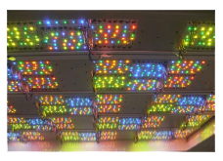
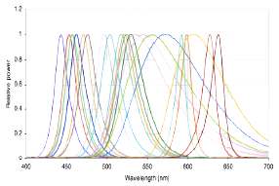
Evaluation room at NIST
Notes:
Since 2006 many evaluations are done. Also in the evaluation room at NIST.
22 color channels via LEDs are used to generate many possible spectra with their own characteristics.

Slide 26
Experimental spectra
Notes:
The test will focus on how well colors are perceived of objects in the room, and how well skin colors are perceived.

Slide 27
Results: Room evaluation

Slide 28
Results: Skin evaluation

Slide 29
CQS available
The CQS v9.0 will from mid Feb be an addition to OliNo lamp measurements
Some changes may occur as the metric is not adopted yet (scaling factor)?
The metric has many improved elements over the CRI
More Info: www.OliNo.org

