Slide 1
LED lamps and possible flicker
Explanations and measurement results
Notes:
My name, work for OliNo
I will talk a bit about OliNo
Then the results of our investigations on Lifetime, Flicker and S/P

Slide 2
LED lamps flicker - init
Article NP in 2009, headaches and led lighting
Fast (100 Hz) variations of light intensity?
→ Due to power supply/driver → varying output
What to measure – no norms?

Slide 3
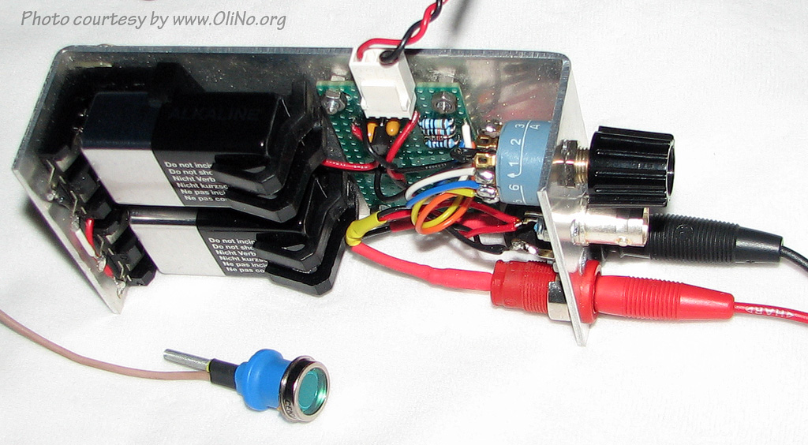
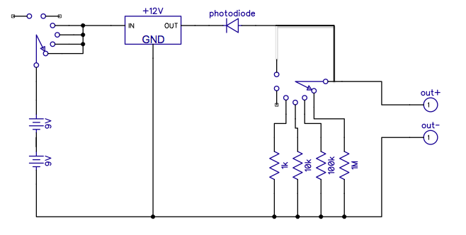
Measurement setup
Photo diode
Amplifier
Fast, up to 5000 Hz

Slide 4
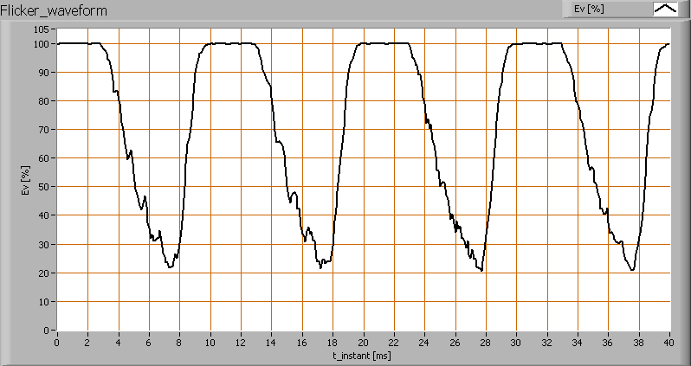
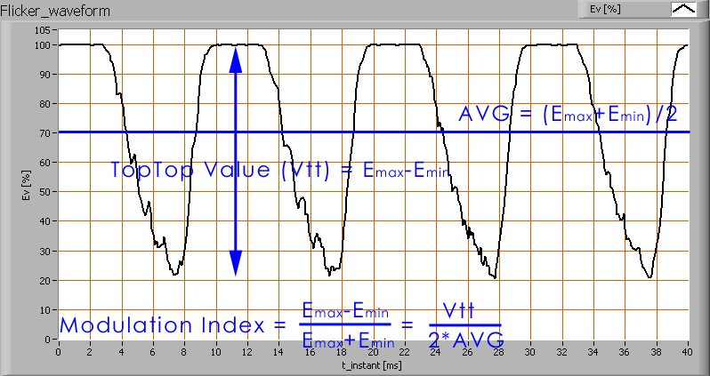
Measurement parameter
Fast variations in illuminance
Look for parameter
Modulation index in %

Slide 5
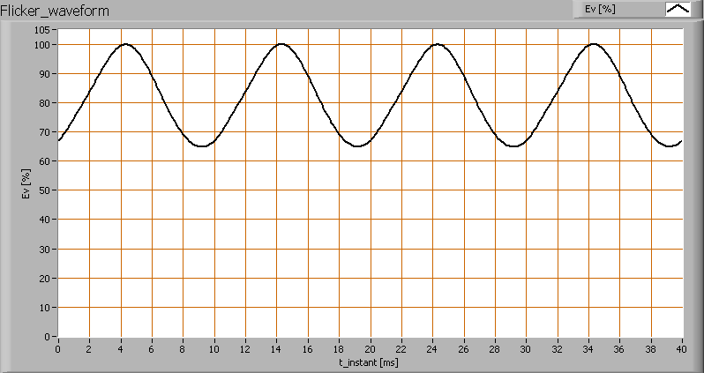
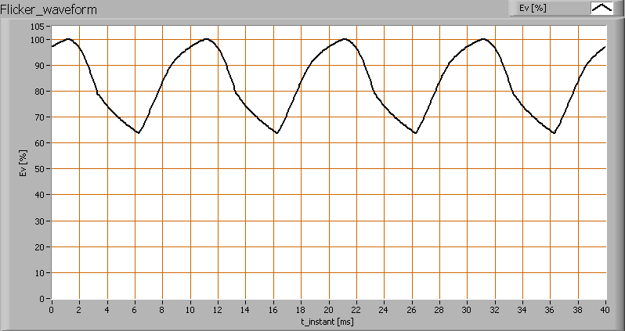
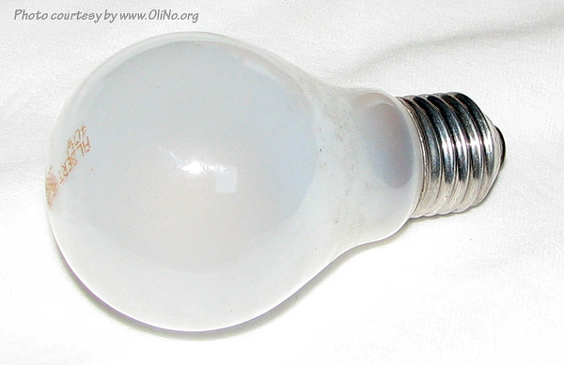
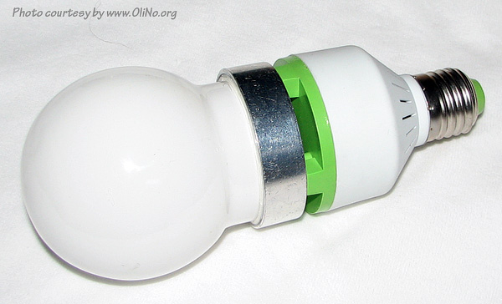
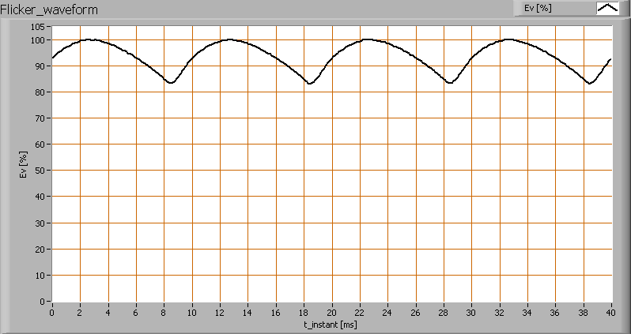
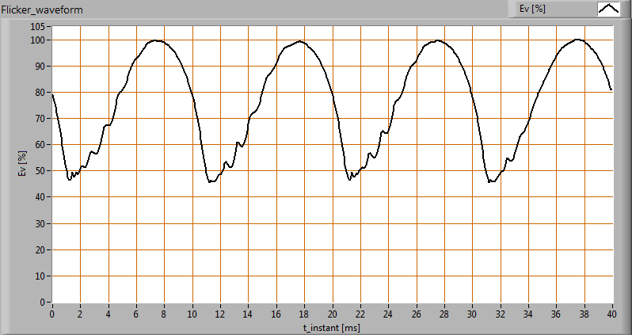
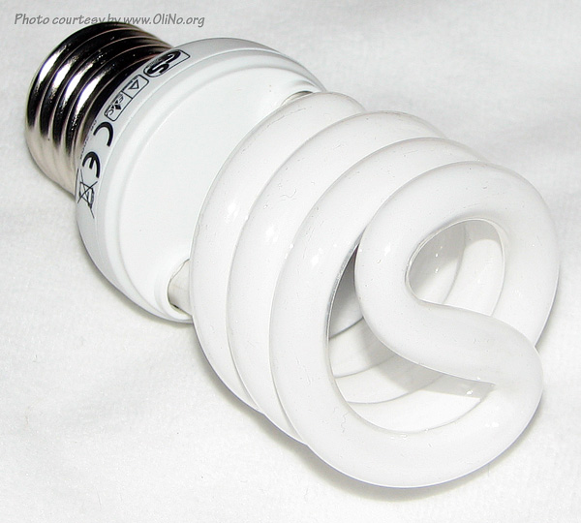
Measurement results
22%
22%
37%
TL + VSA
9%

Slide 6
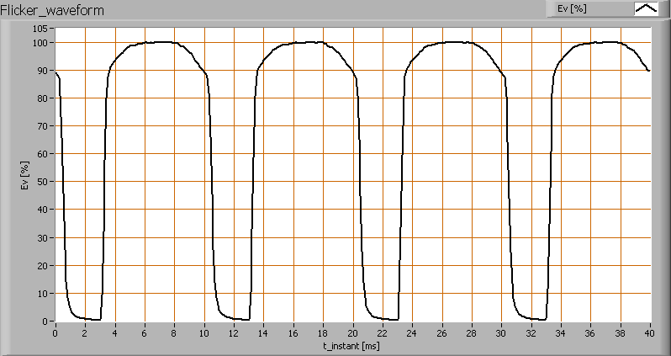
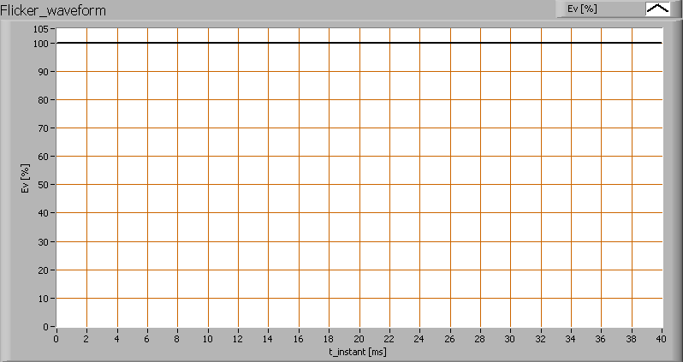
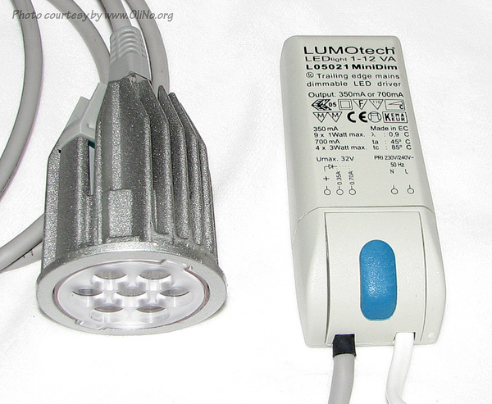
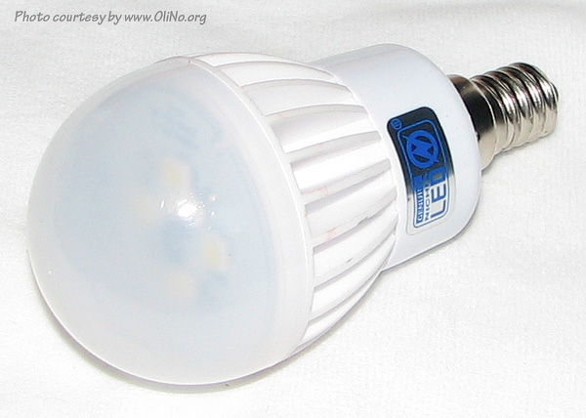
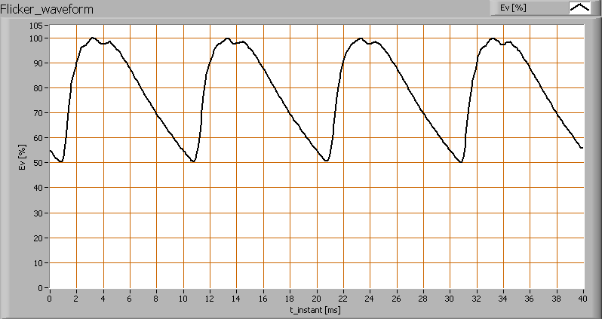
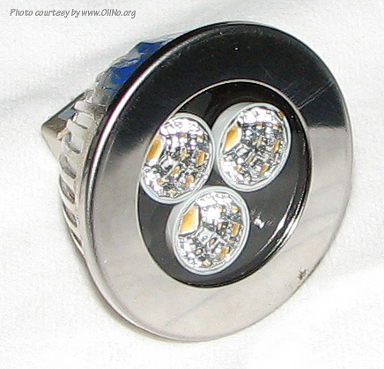
Measurement results
100%
0%
12V AC
12V DC
Not led but power supply issue
33%
0%

Slide 7
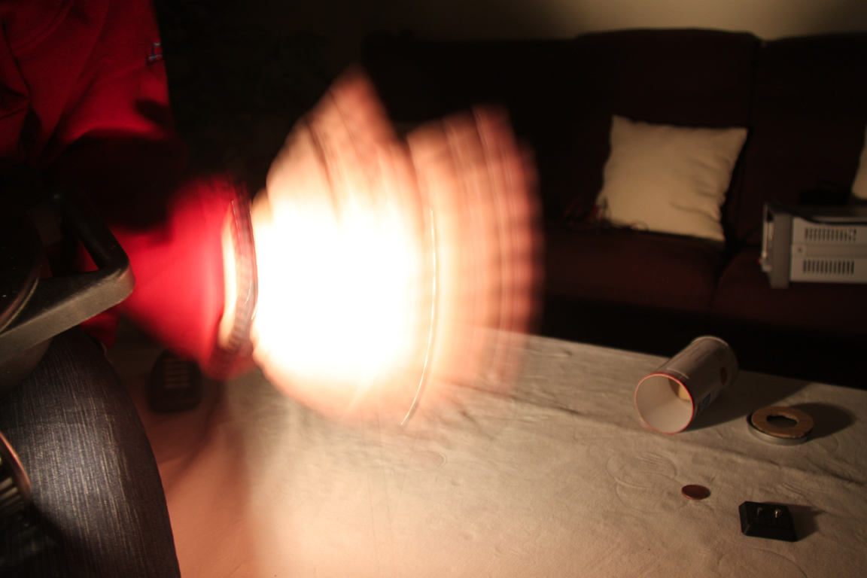
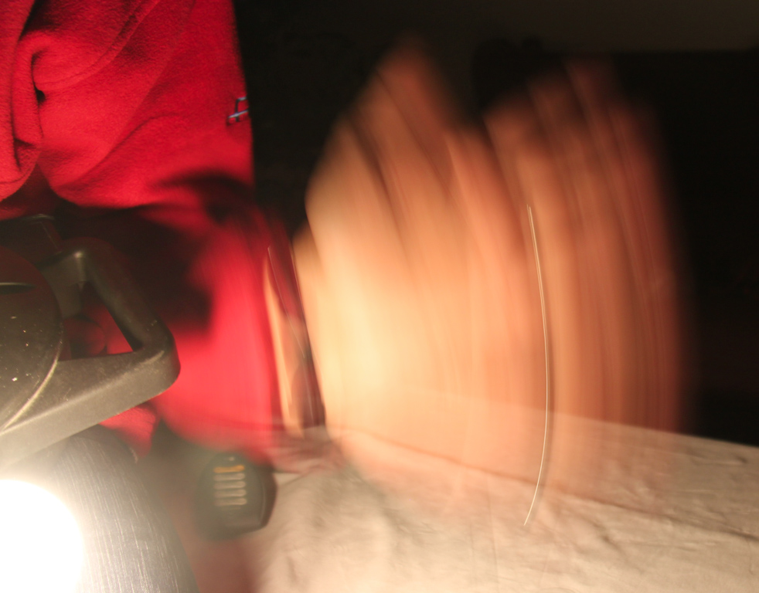
Easy test
When high modulation depth → stroboscopic effect. Left 0, right 0.55
Notes:
Test the stroboscopic effect by waving fast with your hand and check what you see.
If it is one solid smurred image then there is no or little intensity modulation. When you see multiple instances of your hand (see the fingers, thumb, and ring on the picture on the right) then there is a certain intensity variation.

Slide 8
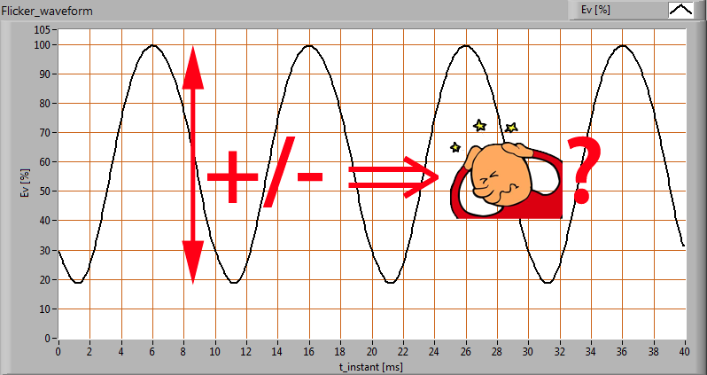
Flicker overview
Fast (100 Hz) variations of light intensity
Due to power supply/driver → varying output
Modulation depth
=top-top / 2*average
Can lead to headaches
When > ? %

Slide 9
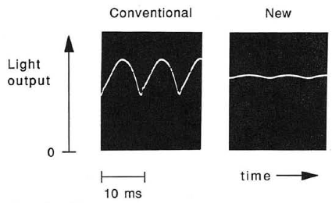
Flicker at lamps investigation
Study Fluorescent lighting, headaches and eyestrain from 1989
Fluorescent tubes+choke ballast (45 %) vs tubes + electronic ballast (7 %)
Exchange of tubes unknown
Double blind study

Slide 10
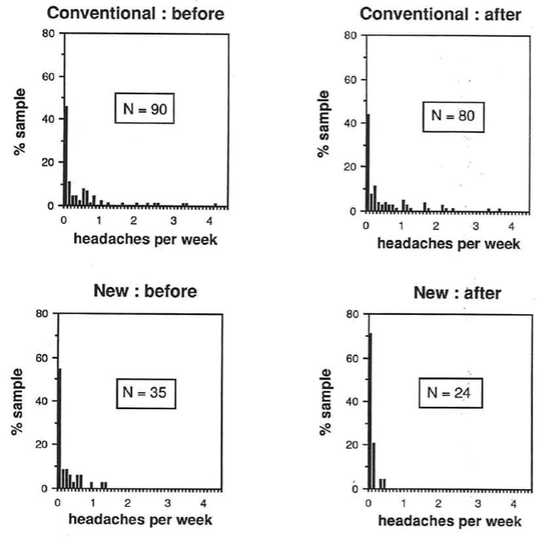
Flicker at lamps investigation
Amount of eyestrain and nr of headaches were monitored
New light significantly less initial and after change into
More natural light (higher levels in building) less headaches

Slide 11
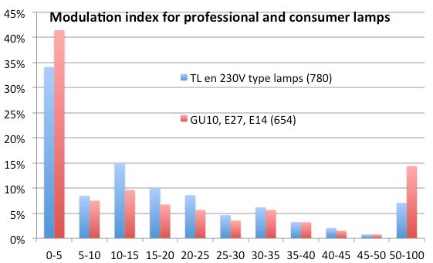
Flicker results
Try to be below 30 – 35
87 % Prof
80 % Consumer
Notes:
Of the 100 tested and reviewed lamps the majority has an modulation depth of < 35 so 24 have a higher modulation depth. Not to be used in a machine room!

Slide 12
Flicker overview
Fast (100 Hz) variations of light intensity
Due to power supply/driver → varying output
Modulation depth
=top-top / 2*average
Can lead to headaches
When > 35 %

Slide 13
Articles on OliNo.org
Flickering:
http://www.olino.org/us/articles/2010/04/12/the-flickering-of-light-bulbs
http://www.olino.org/articles/2010/03/09/het-knipperen-van-lampen
http://www.olino.org/articles/2014/01/30/het-knipperen-van-lampen-wat-is-toelaatbaar

